Slide 1
6502 ASSEMBLY
PRESS START
DealerOn
NICK ROGERS
2018
Notes:
What’s the 6502? It’s the chip that powered my childhood. I’ve been into technology since I was young, here’s proof

Slide 2
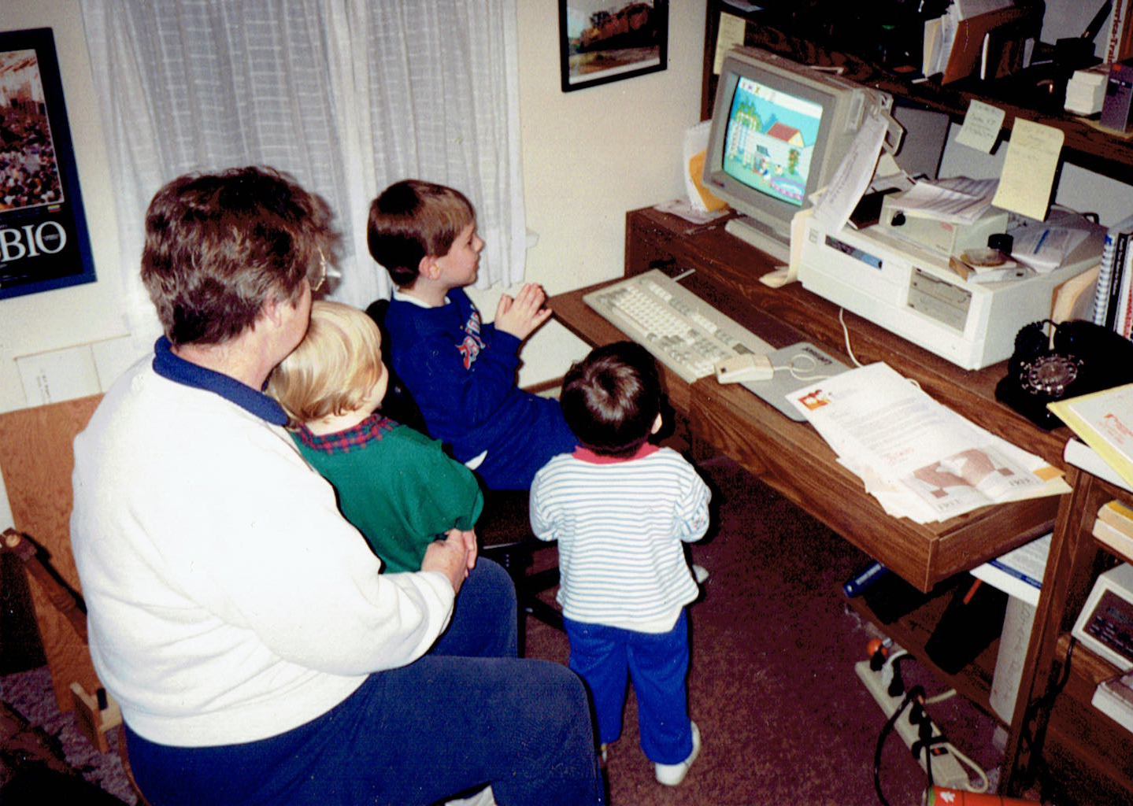
Notes:
Donald's Alphabet Chase

Slide 3
LEVEL 1
ABOUT THE 6502

Slide 4
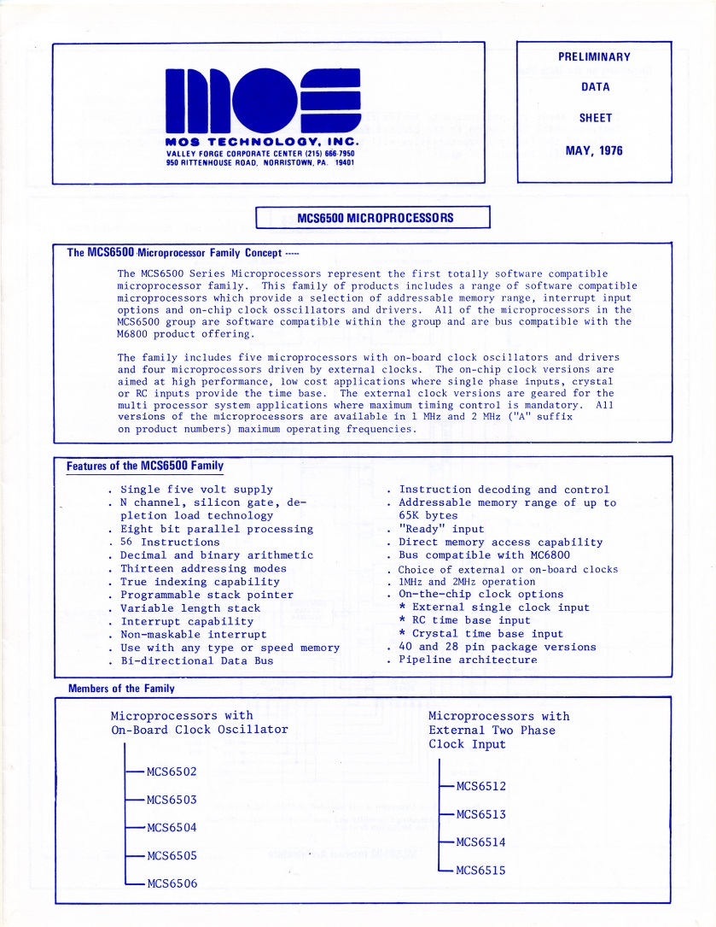
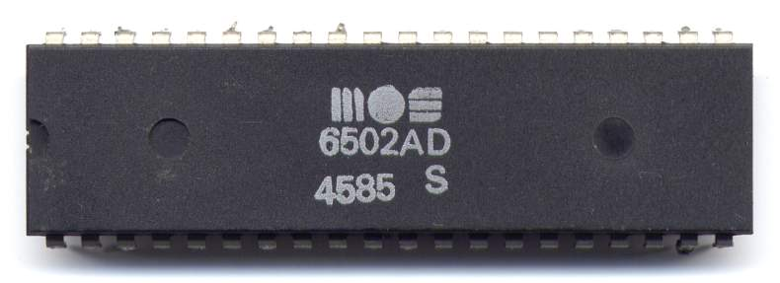
MOS 6502 PROCESSOR
Apple II
Atari 2600
Commodore 64
Nintendo NES
Tamagotchi
Notes:
MOS introduced the 6501 in 1975, intended to be compatible with a more expensive Motorola processor. Motorola didn’t like that very much, MOS got sued, the 6502 was born

Slide 5
COMPARISON
 | MOS 6502 | Intel Core i7-6700
Clock speed (ops/s) | 1-3 MHz | 3,400 MHz
Cores | 1 | 4
Threads/core | 1 | 8
Bit width | 8-bit data, 16-bit addresses | 64-bit
Max-addressable memory | 64 KB | 32 GB
Number of instructions | 56 | 2,000+
Price (today) | $10 | $315
Vulnerable to Meltdown? | No | Yes

Slide 6


ASSEMBLY LANGUAGE
A program written in assembly language consists of a series of instructions intended to be executed directly by the computer’s processor.
A text file containing assembly language instructions is assembled into object files containing machine language and then linked into an executable program.
A
S
S
E
M
B
L
E
R
program.o
LINKER
program.asm
program.exe
header.asm
header.o
Notes:
Object file: Machine language code which is not directly executable. Linker: Resolves references to external libraries/system functions and writes a properly-formatted executable

Slide 7
MACHINE LANGUAGE
Assembly language is composed of opcodes and operands, mnemonics for machine language. There is usually a 1 to 1 correspondence between assembly and machine language.
Opcodes
Operands
Opcodes
Operands
LDA $0400
CMP #$64
BNE $8010
INC $0410
LDA #$00
STA $0400
AD 00 04
C9 64
D0 08
EE 10 04
A9 00
8D 00 04
6502 Assembly
6502 Machine
Notes:
Machine language is the only thing a processor understands. All program languages are converted to machine language somehow. It’s just bytes. Assembly can be converted to machine in a single pass. Addresses are little endian in machine language

Slide 8
INTRO TO ASSEMBLY LANGUAGE
Load the value in memory location 0x0400
Compare it with 0x64 (dec 100)
Skip (“branch”) later in the program if they are not equal
Increment the value in memory location 0x0410
Load the literal value 0x0 (dec 0)
Store it in memory location 0x400
LDA $0400
CMP #$64
BNE $8010
INC $0410
LDA #$00
STA $0400
Notes:
Taste of what opcodes are available in the 6502. Before we dive into that, let’s talk about the registers in the 6502.

Slide 9
PROCESSOR REGISTERS
Most operations cannot be performed directly on values in memory. The value must be loaded into a register in the processor and then stored back into memory later.
A
A is the accumulator. Values are loaded into A to have mathematical and logical operations performed on them.
X
Y
X and Y are index registers, typically used as counters in loops, but can also temporarily store values like A does.
P
P is the processor status register. It is a read-only register which contains a byte whose bits represent information about the processor’s status and the result of the previous operation.
SP
The stack pointer holds the low byte of the address of the item on the top of the stack. This pointer is decremented when items are pushed onto the stack and incremented when items are popped off.
PC
The program counter holds the 16-bit address of the currently executing instruction. Its value is pushed to the stack when a subroutine begins so the processor knows where to return to.
Notes:
This is still true for modern processors, it’s much slower and wasteful to write a value to main memory every time. (L1, L2 cache) The stack is a descending stack, meaning the item on the bottom of the stack is stored at the very end of the memory allocated for the stack.

Slide 10
ADDRESSING MODES
The lda instruction loads a value into the processor’s accumulator (A). Where that value comes from depends on what addressing mode is used.
Instruction | Op | Name | Description
lda #$42 | A9 | Immediate | Loads the literal value 42 in hex (dec 66)
lda $42 | A5 | Zero Page | Loads the value in memory location 0x0042
lda $42,X | B5 | Zero Page Indexed | Loads the value in 0x0042, offset by X
lda $4200 | AD | Absolute | Loads the value in 0x4200
lda $4200,X | BD | Absolute Indexed | Loads the value in 0x4200, offset by X
lda $4200,Y | B9 | Absolute Indexed | Loads the value in 0x4200, offset by Y
Notes:
Pages of memory are 256-byte groups of memory (x0 through xFF for example)

Slide 11
INDIRECT ADDRESSING
There are also two load instructions which use indirect addressing. The address being loaded must be in the zero page and the offset register must be used.
Instruction | Op | Name | Description
lda ($42,X) | A1 | Indexed Indirect | Loads the value in the address stored in (0x0042+X) and (0x0042+X+1)
lda ($42),Y | B1 | Indirect Indexed | Loads the value in the address, offset by Y, stored in 0x0042 and 0x0043
Notes:
So the first one is applying the offset to the argument, and the second is applying the offset to the result. So that’s all the addressing modes there are, let’s talk about some more common instructions.

Slide 12
LOADING AND STORING
More “Load” and “Store” instructions:
Instruction | Name | Description
lda ADDR | Load Accumulator | Loads the value in ADDR into A
ldx ADDR | Load X | Loads the value in ADDR into X
ldy ADDR | Load Y | Loads the value in ADDR into Y
sta ADDR | Store Accumulator | Stores the value of A into ADDR
stx ADDR | Store X | Stores the value of X into ADDR
sty ADDR | Store Y | Stores the value of Y into ADDR
ADDR can be an address or a literal value for load instructions.

Slide 13
COMPARISONS
Conditional expressions consist of a compare instruction followed by a branch instruction.
Instruction | Name | Description
cmp ADDR | Compare Accumulator | Compares the accumulator with ADDR
cpx ADDR | Compare X | Compares X with ADDR
cpy ADDR | Compare Y | Compares Y with ADDR
How is the result of the comparison encoded in the 6502?

Slide 14
PROCESSOR STATUS REGISTER
P
P is the processor status register. It is a read-only register which contains a byte whose bits represent information about the processor’s status and the result of the previous operation.
Carry: Previous operation resulted in a carry
Zero: Previous operation resulted in 0 value
Interrupt: Interrupts enabled
Decimal: Decimal mode enabled
oVerflow: Previous operation resulted in an overflow
Negative: Bit 7 of the previous operation, 1 if negative
NV--DIZC
Notes:
Decimal = fractional parts of numbers. Binary-coded decimal (BCD)

Slide 15
COMPARISONS
A comparison of two values is performed by simply subtracting the memory value from the register value, setting the following processor flags accordingly:
Comparison Result | N | Z | C
A = B | 0 | 1 | 1
A < B | B7 | 0 | 0
A > B | B7 | 0 | 1
Where A is the register value and B is the memory value or literal. The N flag is set to bit 7 of the subtraction operation.
Notes:
The sign bit -- if the subtraction yielded a negative number, N would be set to 1.

Slide 16
BRANCHES AND CONTROL FLOW
Control flow is typically managed by branch operations after a comparison operation has been executed and the processor flags have been appropriately set.
Instruction | Op | Name | Description
bpl VAL | 10 | Branch on Plus | Previous result was positive
bmi VAL | 30 | Branch on Minus | Previous result was negative
bvc VAL | 50 | Branch on Overflow Clear | Overflow flag (V) is not set
bvs VAL | 70 | Branch on Overflow Set | Overflow flag (V) is set
bcc VAL | 90 | Branch on Carry Clear | Carry flag (C) is not set
bcs VAL | B0 | Branch on Carry Set | Carry flag (C) is set
bne VAL | D0 | Branch on Not Equal | Zero flag (Z) is not set
beq VAL | F0 | Branch on Equal | Zero flag (Z) is set
VAL is the number of bytes to branch forward or backward. VAL can be in the range [-128, 127]. What if we want to branch by more?
Notes:
VAL is a signed number

Slide 17
MORE CONTROL FLOW
Branch operations are relative. These control flow instructions are non-relative:
Instruction | Op | Name | Description
jmp ADDR | 4C | Unconditional Jump | Transfers program execution to ADDR
jmp (ADDR) | 6C | Indirect Jump | Transfers program execution to the value located in ADDR and ADDR+1
jsr ADDR | 20 | Jump Subroutine | Pushes current PC address onto stack and then transfers program execution to ADDR
rts | 60 | Return from Subroutine | Pulls address from top of stack and transfers program execution there
rti | 40 | Return from Interrupt | Pulls processor status and then address from stack and transfers program execution there

Slide 18
MORE CONTROL FLOW
“Long branches” can be achieved by inverting the condition and adding a jmp instruction to the intended target. The jmp instruction will be skipped if the inverted condition is true.
CMP #$0A
BEQ $96F3
CMP #$0A
BNE :+
JMP $96F3
:
Error: Range error (1949 not in [-128..127])
Shorthand for “the next colon label”

Slide 19
BITWISE OPERATIONS
Instruction | Name | Description
and ADDR | AND with Accumulator | Bitwise AND
bit ADDR | Bit Test | AND operation without modifying A
ora ADDR | OR with Accumulator | Bitwise OR
eor ADDR | XOR with Accumulator | Bitwise XOR
asl ADDR | Arithmetic Shift Left | Shift all bits left one position, 0 shifted into bit 0, bit 7 shifted into C
rol ADDR | Rotate Left | Shift all bits left one position, C shifted into bit 0, bit 7 shifted into C
ror ADDR | Rotate Right | Shift all bits right one position, C shifted into bit 7, bit 0 shifted into C
There is no instruction for logical NOT (complement of a number). What can be used instead?
Notes:
EOR $FF

Slide 20
ARITHMETIC OPERATIONS
Instruction | Name | Description
adc ADDR | Add with Carry | Stores the result of A+C+ADDR in A
sbc ADDR | Subtract with Carry | Stores the result of A-ADDR-(1-C) in A
inc ADDR | Increment | Adds 1 to value in ADDR
inx | Increment X Register | Adds 1 to value in X register
iny | Increment Y Register | Adds 1 to value in Y register
dec ADDR | Decrement | Subtracts 1 from value in ADDR
dex | Decrement X Register | Subtracts 1 from value in X register
dey | Decrement Y Register | Subtracts 1 from value in Y register
There are no instructions for multiplication or division. What can be done instead?
Notes:
That was 80% of the instructions available for the 6502. Now let’s talk about how to develop for a hardware platform, specifically the NES

Slide 21
LEVEL 2
DEVELOPING FOR
THE NINTENDO NES

Slide 22
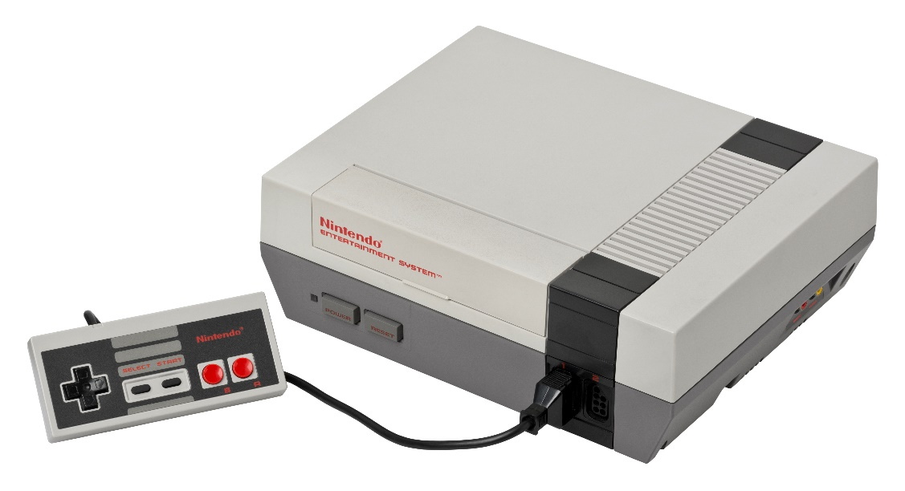
NINTENDO ENTERTAINMENT SYSTEM
Specification | Value
CPU | Ricoh 2A03 (6502 compat.)
PPU | Ricoh 2C02
Work RAM | 2 KB
Video RAM | 2 KB
Display resolution | 512 x 480 pixels (256 x 240 pixels visible)
Colors | 48
Sound channels | 2 square waves, 1 triangle wave, 1 white noise, 1 PCM
Notes:
CPU was completely compatible with the 6502, except it removed support for decimals. “Illegal black”

Slide 23
MEMORY MAP
Work RAM: 0x0000 – 0x07FF (2KB)
Mirrors of Work RAM: 0x0800 – 0x1FFF (2KB repeated)
PPU Registers and Mirrors: 0x2000 – 0x3FFF (8 bytes repeated)
Graphics Data: 0x4000 – 0x7FFF (16 KB)
Game Cartridge: 0x8000 – 0xFFFF (32 KB)
Notes:
Certain items are mirrored (repeated) in the NES’s memory simply because it allows the CPU to ignore some of the bits of a memory address.

Slide 24
MEMORY MAP
NES
???
Mega Man 2
256 KB
Notes:
Remember the CPU can’t address anything past 64 KB? How can games be larger than that, then? The biggest NES cartridge was 1 MB.

Slide 25
MEMORY MAP
NES
Mega Man 2
256 KB
PRG0
PRG1
PRG2
PRG3
PRG4
PRG5
PRG6
PRG7
PRG8
PRG9
PRGA
PRGB
PRGC
PRGD
PRGE
PRGF
Notes:
This varies by game, but cartridges can support bank switching, where the game swaps out which banks are addressable by the NES

Slide 26
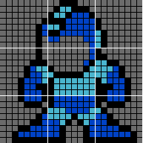
GRAPHICS
NES graphics are composed of 8x8 pixel tiles in the game’s character ROM. These tiles can be sprites or background tiles.
Sprites are graphical elements on the screen that can move, be animated, or change color. Sprite data is stored in OAM, a special 256-byte range of memory. Each sprite’s data is 4 bytes, therefore a maximum of 64 sprites can be visible on the screen at once.
Byte 0: Y position
Byte 1: Tile index
Byte 2: Attributes (color palette, Z position, flip horizontal, flip vertical)
Byte 3: X position
Background tiles must be aligned to an 8x8 grid, but there is no limit to the amount that can be on the screen.
MARIO
056200
Notes:
Controllable characters and things they interact with are (usually) sprites.

Slide 27
BACKGROUND GRAPHICS
Background graphics are stored in 4 nametables, areas of the NES’s RAM. Each byte of each nametable controls an 8x8 pixel region of the screen. To display a specific background tile, you simply need to place its tile index in the desired location.
(0,0)
1 0x2000 | 2 0x2400
3 0x2800 | 4 0x2C00
Because the NES does not have enough RAM to handle four nametables, two of the regions will be mirrored.
Vertical mirroring: Nametables 1 == 3 and 2 == 4
Horizontal mirroring: Nametables 1 == 2 and 3 == 4
One-screen mirroring: All nametables are the same
A smooth “scrolling” effect can be achieved by rapidly incrementing the bounds of which region is visible on the screen.
(511, 479)

Slide 28
V-BLANK
For every frame of video, an NMI is generated for the V-Blank period. This is the period of time when the PPU is “resting”. When the NMI is raised, the game immediately jumps to your predefined NMI address and runs your code related to preparing graphics to be drawn.
1 video frame: (~30,000 cycles)
PPU Active
V-Blank (~2,250 cycles)
Game logic should be run while the PPU is active and graphics code should be run during V-Blank. It’s important not to attempt to draw to the screen outside of the V-Blank period, otherwise strange artifacts can appear on the screen. You can reliably copy about 160 bytes worth of data during V-Blank. If you have a lot of drawing to do, the PPU can be disabled and then game and graphics logic can be mixed.
Notes:
It’s the period of time when the electron beam of a tube television resets back to the top of the display. Disable PPU during screen transitions.

Slide 29
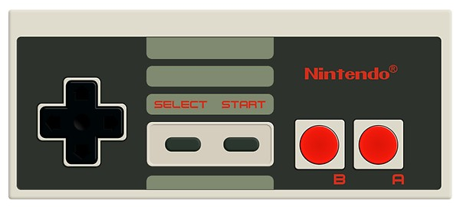
CONTROLLER INPUT
Controller input is mapped to two locations in memory: 0x4016 for controller 1 and 0x4017 for controller 2. Each button is mapped to a bit, which can then be ANDed to determine if it is being pressed or not.
00000000

Slide 30
CONTROLLER INPUT
Controller input is mapped to two locations in memory: 0x4016 for controller 1 and 0x4017 for controller 2. Each button is mapped to a bit, which can then be ANDed to determine if it is being pressed or not.
$88 =
10001000

Slide 31
LEVEL 3
MARS ROVERS
...THE GAME!

Slide 32
